Slide 1
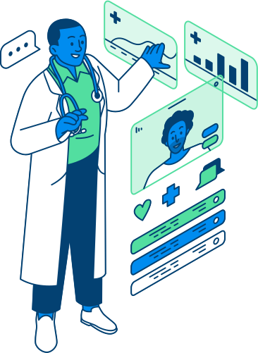

ACCESSIBLE CARE TO EVERYONE
FALL DETECTION CHEST STRAP
MARIA ANTONOVA
SADMAN SHOWMIK
NIKO SALMELAINEN
JINGYAO WANG

Slide 2
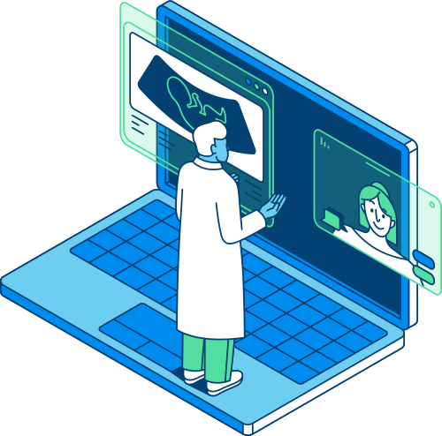
ABOUT US
HACKATHON TEAM
We are second-year students from the Electronics degree at Metropolia UAS.
We are highly motivated students who seek to apply the academic knowledge and practical background we have gained during our university studies.

Slide 3
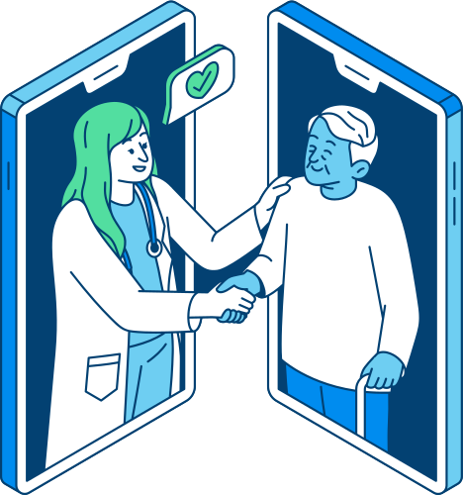
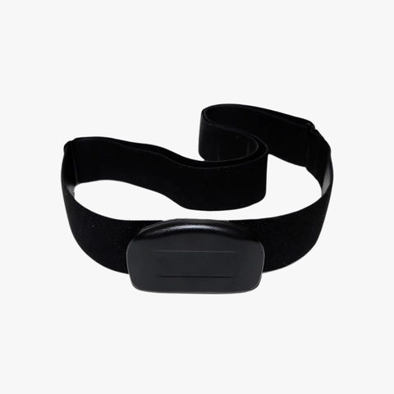
MISSION
The mission of this chest strap is to provide exceptional and accessible healthcare to all elderly individuals. It enhances their safety by detecting a strong fall and alerting medical personnel and the possible emergency contact(s) of the person in danger.
VISION
Our vision is to enhance the quality and accessibility of medical technologies through smart sensors and advanced innovations.

Slide 4
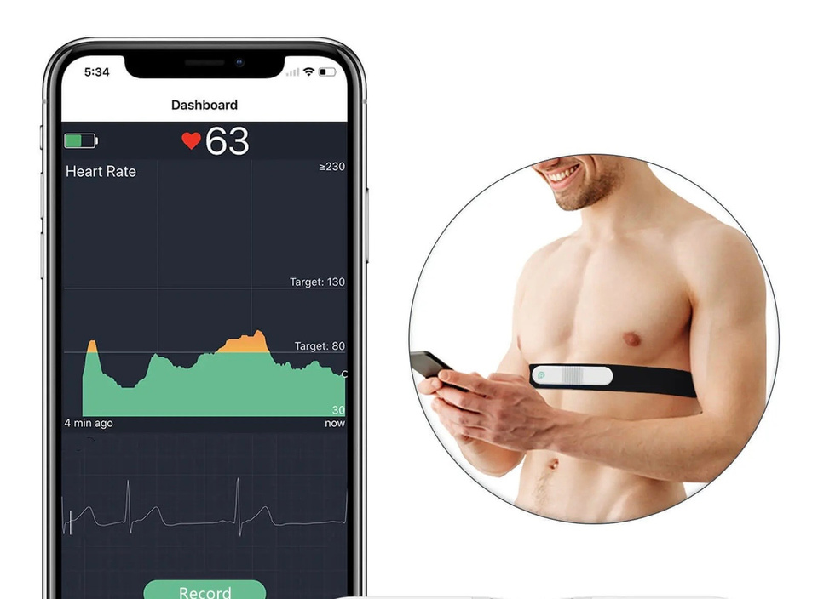

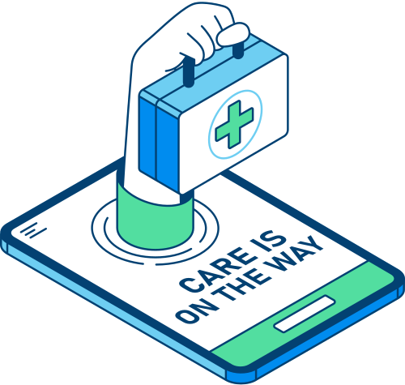

MORE DETAILS
Falls are a major health risk for elderly individuals, especially those living alone
Many elderly people struggle to get help in time, leading to severe injuries or complications
Negligence or medical conditions like heart attacks can lead to dangerous falls
Equipped with Sensors
Accelerometer & Gyroscope
Emergency Contact System
PPG Sensor Integration
Design for Elderly Users
Secure Fit (dementia patients)
Soft, Hypoallergenic Material

Slide 5
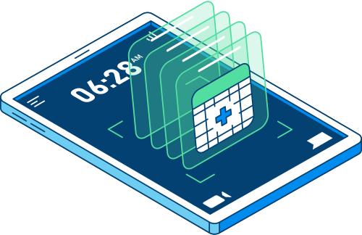
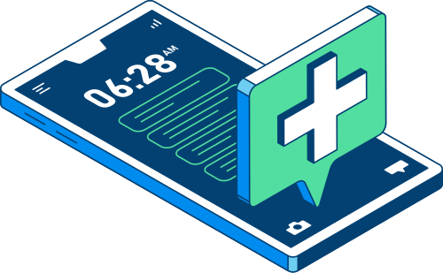
PROCESS
HEART BEAT ALARM
START
GET BIO SIGNAL
UC PROCESSES THE DATA
UPDATE AND MONITOR CONTINUOUSLY
REPEAT PROCESS
FALL ALARM
BUZZER

Slide 6

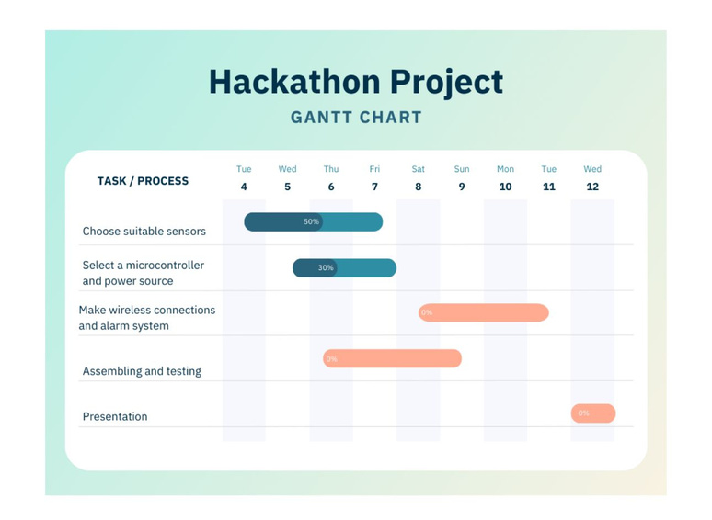
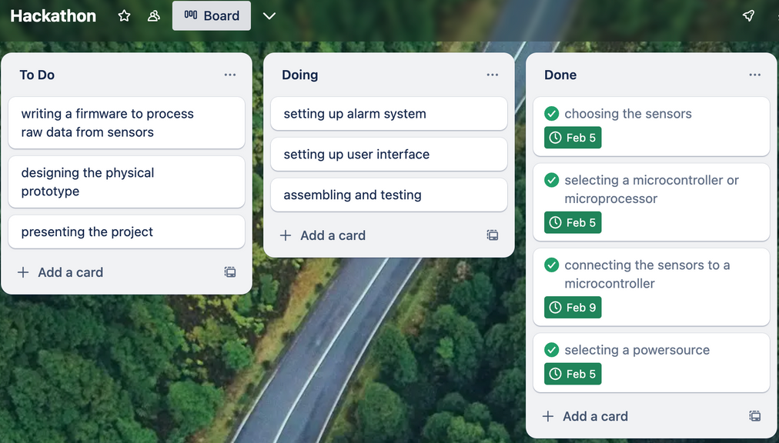
PROJECT
MANAGEMENT
Trello
Gantt Chart
Canva

Slide 7
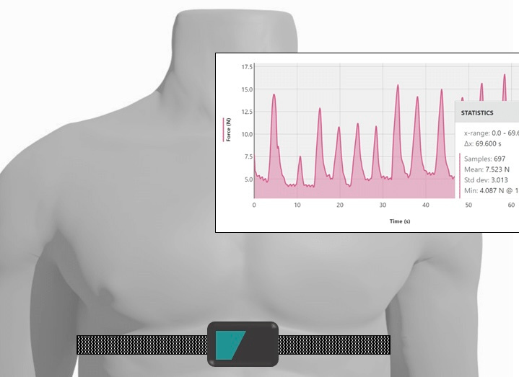
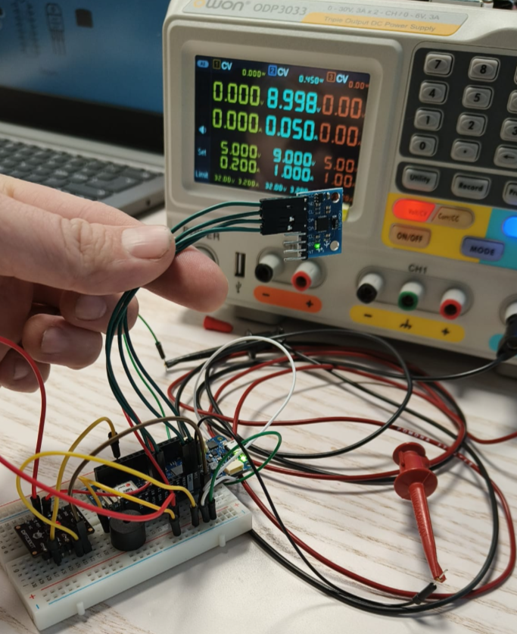
TECHNICAL
SIDE
Arduino MKR 1010 Wifi
GY-521
DFRobot MX30102
5V buzzer
Blynk IoT

Slide 8


SCOPE OF IMPROVEMENTS
Lowering the Power Consumption
More User-Friendly Interface
Sim card reader
Off button in the case of a false alarm
MQTT
Add Other Sensors to make it a functional 360-degree health solution
Comfortable design

Slide 9




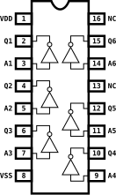


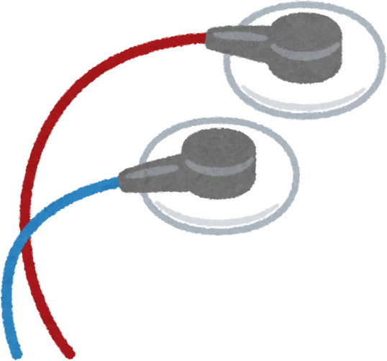
WHAT DID WE LEARN?
Project Management
Hardware
Software
Teamwork
Sensors

Slide 10
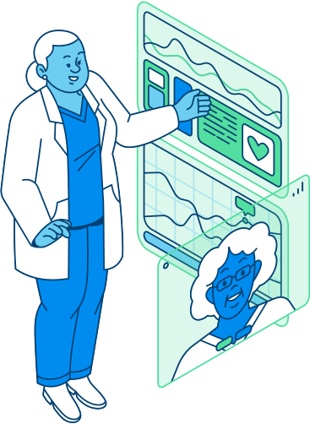
HACKATHON PROJECT
THANK YOU!
QUESTIONS?

